Slide 1
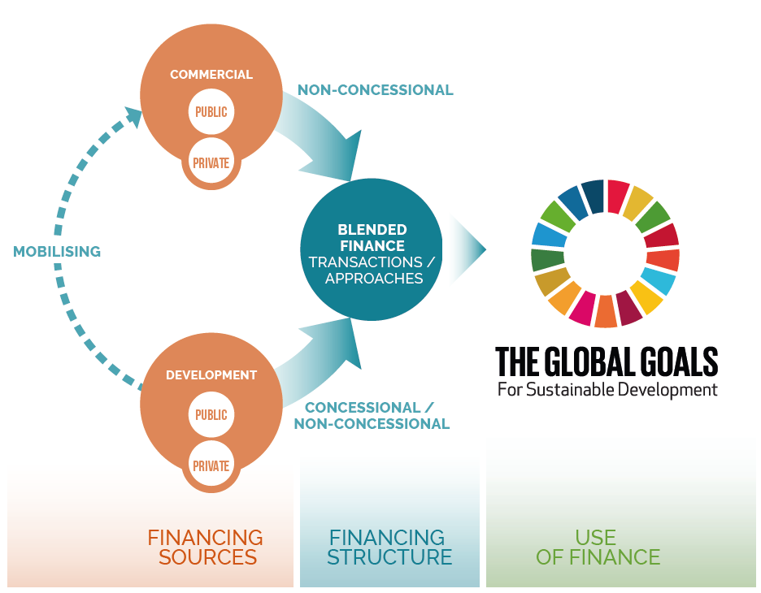
Blended finance can help bridge the investment gap for the SDGs, but requires a common framework
What is blended finance?
Blended finance is the strategic use of development finance for the mobilisation of additional finance towards sustainable development in developing countries.

Slide 2
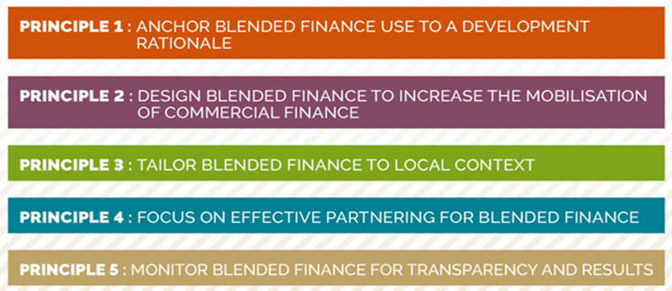
OECD DAC Blended Finance Principles present a blueprint for better blending
Source: OECD DAC Blended Finance Principles

